Slide 1
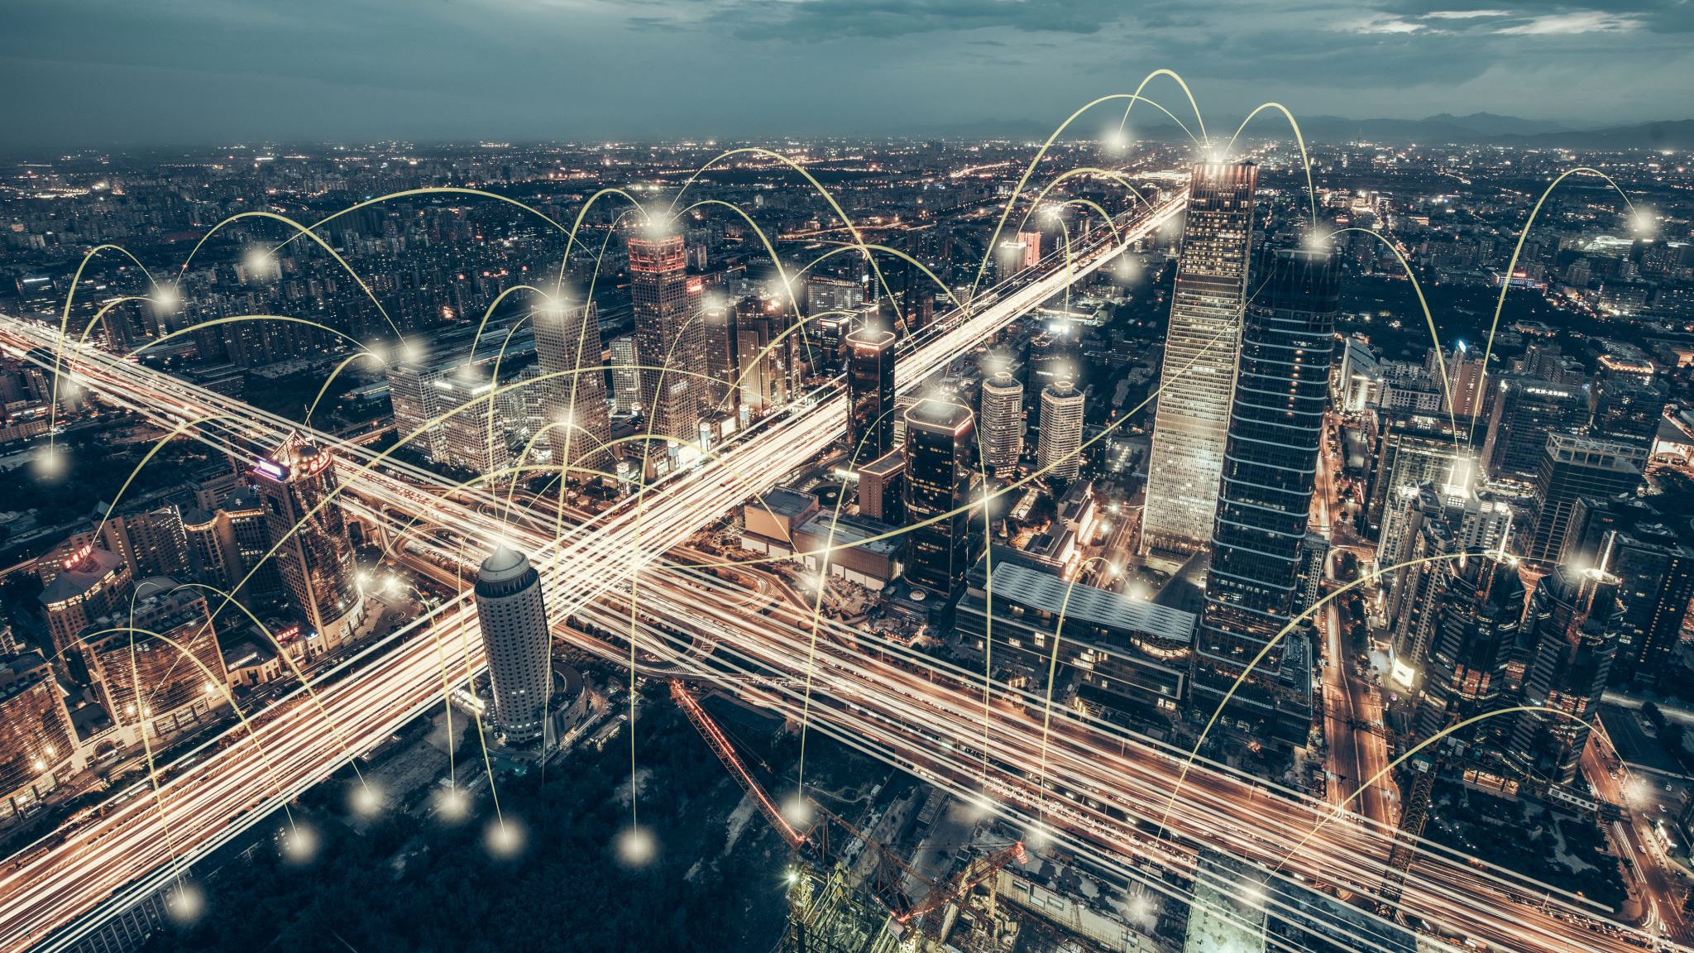
IoT and Transportation
How IoT shapes the way we think about modern transformation

Slide 2
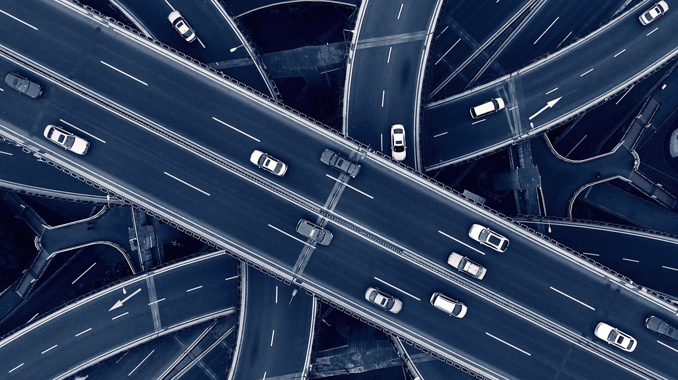
Quote
A developed country is not a place where the poor have cars. It's where the rich use public transportation.
― Gustavo Petro.

Slide 3

Quick Facts about IoT
IoT market value in 2015 was 15.41 billion USD. (Roughly the same price of UBER)
IoT market value in 2021 was 82.7 billion USD. (The same price of INTEL )
IoT market value is estimated to be 621.8 billion USD (Roughly the same size of Sweden’s GDP)

Slide 4

Quick Facts about connected cars
2013
In 2013 there was 23 millions connected cars across the globe.
2021
In 2021 there was 237 millions connected cars across the globe.
2025
Connected cars are estimated to reach 400 million cars by 2025.

Slide 5
Purpose of the presentation
The main purpose of the presentation is to shine light on the effect of IoT in Transportation, and how it changed and will change the whole experience of transportation.

Slide 6
Outline.
1. Biggest problems of Transportation
2. How IoT addressed the Transportation problems.

Slide 7
Transportation problems
Traffic congestion
Fleet management inefficiencies
Lack of real-time information for travellers
Road safety and accident prevention
Parking inefficiencies
Environmental impact

Slide 8
1. Traffic Congestion
Heavy traffic congestion leads to increased travel times, fuel consumption, and pollution, impacting both commuters and the environment.

Slide 9
2. Fleet management inefficiencies
Fleet managers often struggle with optimizing routes, monitoring vehicle health, and efficiently managing maintenance schedules.

Slide 10
3. Lack of Real-Time info for travelers
Travelers often face uncertainty due to limited or inaccurate information about public transportation schedules and availability.

Slide 11

4. Road safety and accident prevention
Road accidents and unsafe driving behaviors contribute to a significant number of injuries and fatalities.

Slide 12

5. Parking Inefficiencies
Finding parking spaces in congested areas is time-consuming and contributes to traffic congestion.

Slide 13

6. Environmental Impact
Traditional transportation contributes to air pollution and greenhouse gas emissions.

Slide 14





IoT Solutions
Next, we are going to see the solutions brought by introducing IoT to the transportation Problems

Slide 15
1. Traffic Congestion
IoT-enabled smart traffic management systems can collect real-time data from sensors, cameras, and GPS devices to monitor traffic flow. Analyzing this data helps optimize traffic signals, reroute traffic, and provide dynamic information to drivers, reducing congestion and improving overall traffic management.

Slide 16
2. Fleet management systems.
IoT sensors integrated into vehicles can provide real-time data on fuel efficiency, engine performance, and maintenance needs. This information helps fleet managers optimize routes, reduce downtime, and improve overall fleet efficiency.

Slide 17
3. Lack of real-time information for travellers
IoT-enabled smart transportation systems can provide real-time updates on public transit schedules, vehicle locations, and available services through mobile apps or digital displays at stations. This empowers travellers with accurate information to plan their journeys better.

Slide 18

4. Road safety and accident prevention
IoT devices such as vehicle-to-vehicle (V2V) and vehicle-to-infrastructure (V2I) communication systems can exchange data on speed, location, and other parameters to alert drivers about potential collisions or hazardous conditions, reducing the risk of accidents.

Slide 19

5. Parking Inefficiencies
IoT-based smart parking systems use sensors to detect parking space occupancy and transmit this data to mobile apps, helping drivers find available parking spaces more efficiently. This reduces the time spent searching for parking and decreases traffic congestion.

Slide 20
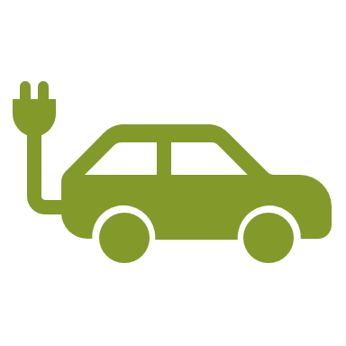
6. Environmental Impact
IoT can enable the development of electric vehicles (EVs) and support charging infrastructure by providing real-time data on charging station availability and performance. Additionally, IoT-enabled logistics management can optimize delivery routes and reduce emissions.

Slide 21

Thank You

